Slide 1
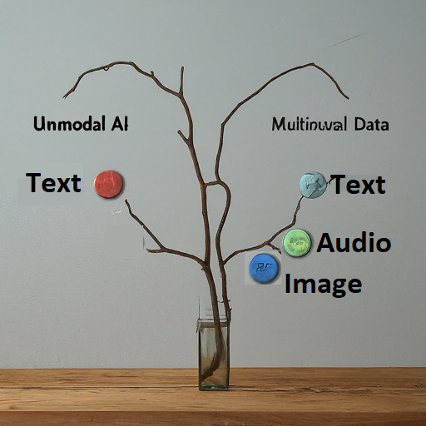
Zaw May
AI Content Creation: Data Collection Stage
Objective
to determine the type of content and data types needed for content creation
to use different AI approaches
Two AI approaches
Unimodal AI for Content Creation (Single Type of Data: Text)
Multimodal AI for Content Creation (Multiple Types of Data: Text, Audio, Video, Visual)

Slide 2
Zaw May
Dividing Data by Specific Fields
Identify Specific Fields (health, finance, technology, education)
Identify Data Types
Label Data Categories
Kinds of data to be collected
Articles and Blog Posts
Books and Literature
Research Papers
News Articles
Social Media Posts
FAQs and feedback
Industry Reports
Charts and graphs
Design Templates
Podcasts and audiobooks
Audios and autioscript
Webinars
Tutorials
Videos and Vlogs and a
Images
Target audience data
Webiste analytics

